Slide 1
Making careers in the technology industry more attainable through equitable access to mentorship, education, and career opportunities.

Slide 2
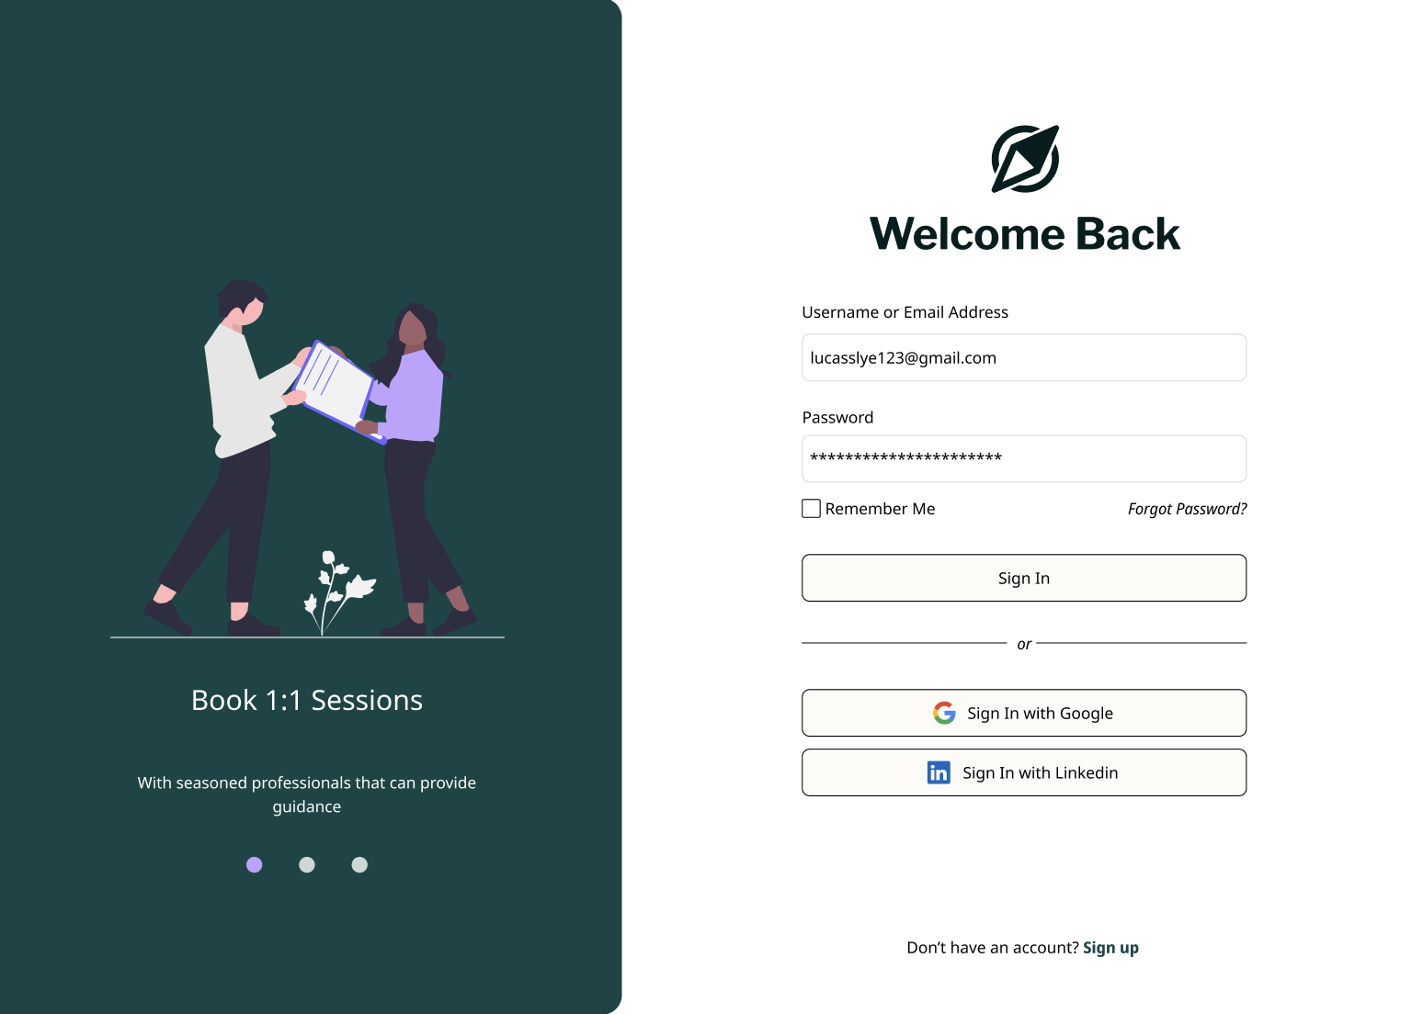
Wevise is an online platform that provides free mentorship for those seeking a career in tech.
Our algorithm instantly curates matches based on specific needs, interests, background, and experience.
Wevise levels the playing field in tech, ensuring that all people have access to mentorship from people who have similar lived experiences.

Slide 3
Why partner with Wevise?

Slide 4
Mentoring programs are complicated
Often added on top of other programs, taking away time
from core competencies and foci
Difficult to find the right (or enough) mentors–if a match isn’t
right, the mentee often doesn’t have another choice
Mentoring program managers are often not trained
in mentorship programs, don’t have time to run
another program, and don’t have the tools
to be effective

Slide 5
Creating a more impactful mentoring program
Curated best matches beyond just career and industry
Similar lived experiences
Gender
Language
Profiles, onboarding, and training on the platform
Immediate matching and multiple options for mentors
Organization portal to view mentoring matches and relationships
Program managers run the program from the platform with reports
Coming soon: scheduling support, video conferencing, chat, multi-lingual support
Notes:
Matches take into account multiple different facets beyond the request itself
Similar lived experiences
Gender
Language and location
Mentors are sent multiple anonymized matches immediately upon finishing profile, removing lag
Organizations can review matches and relationships in the system and communicate easily with users

Slide 6
Options to fit the needs of your organization
Shared mentors: Mentors and mentees join the platform; mentors are shared between programs, offering better matches for mentees
Exclusive matching (self-managed): Mentors and mentees from a program are matched exclusively with each other. The program manager oversees the program
Exclusive matching (Wevise-managed): Mentors and mentees from a program are matched exclusively with each other. A Wevise program manager oversees the program and reports back results to the organization
In all options, the organization has admin access
to review the mentees and their progress.

Slide 7
 | Shared mentors | Exclusive matching (self-managed) | Exclusive matching (Wevise-managed)
Mentor/mentee training | X (asynchronous) | X (determined by company) | X, delivered at beginning of program
Best matches provided | X | X | X
Time saved | 10 min/week/pair | 15 min/week/pair | 30 min/week/pair
Experienced mentor program manager |  | Depends on person in company | X
Dashboard provided | X | X | X, monthly reports provided as well
Scheduling support (coming soon) | X | X | X
Video conferencing (coming soon) | X | X | X
Mentoring session templates (EOY 2024) | X | X, plus ability to run specific program | X, plus ability to run specific program
Cost | Free, beyond bringing in mentors | Per mentee, per month | Per mentee, per month

Slide 8
The platform

Slide 10
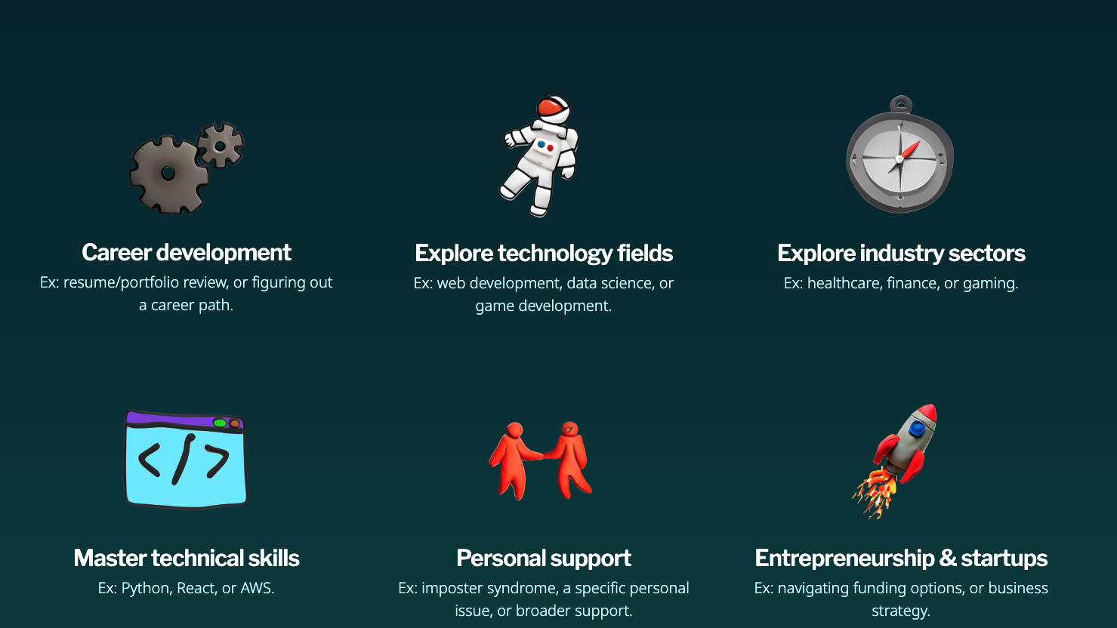
Mentorship topics

Slide 11
Curated matches based on multiple factors
Professional level: mentors are at least one level above the mentee
Gender: mentees and mentors can choose whether they prefer, require, or don’t care if their match is the same gender as them
Personal characteristics (see next slide)
Mentorship request, including up to six tags and a written paragraph
Duration: short, medium, long
We believe in providing mentors with
similar lived experiences as the mentee, as
this increases empathy and allows for
targeted advice on removing barriers

Slide 12
Examples of personal characteristics

Slide 13
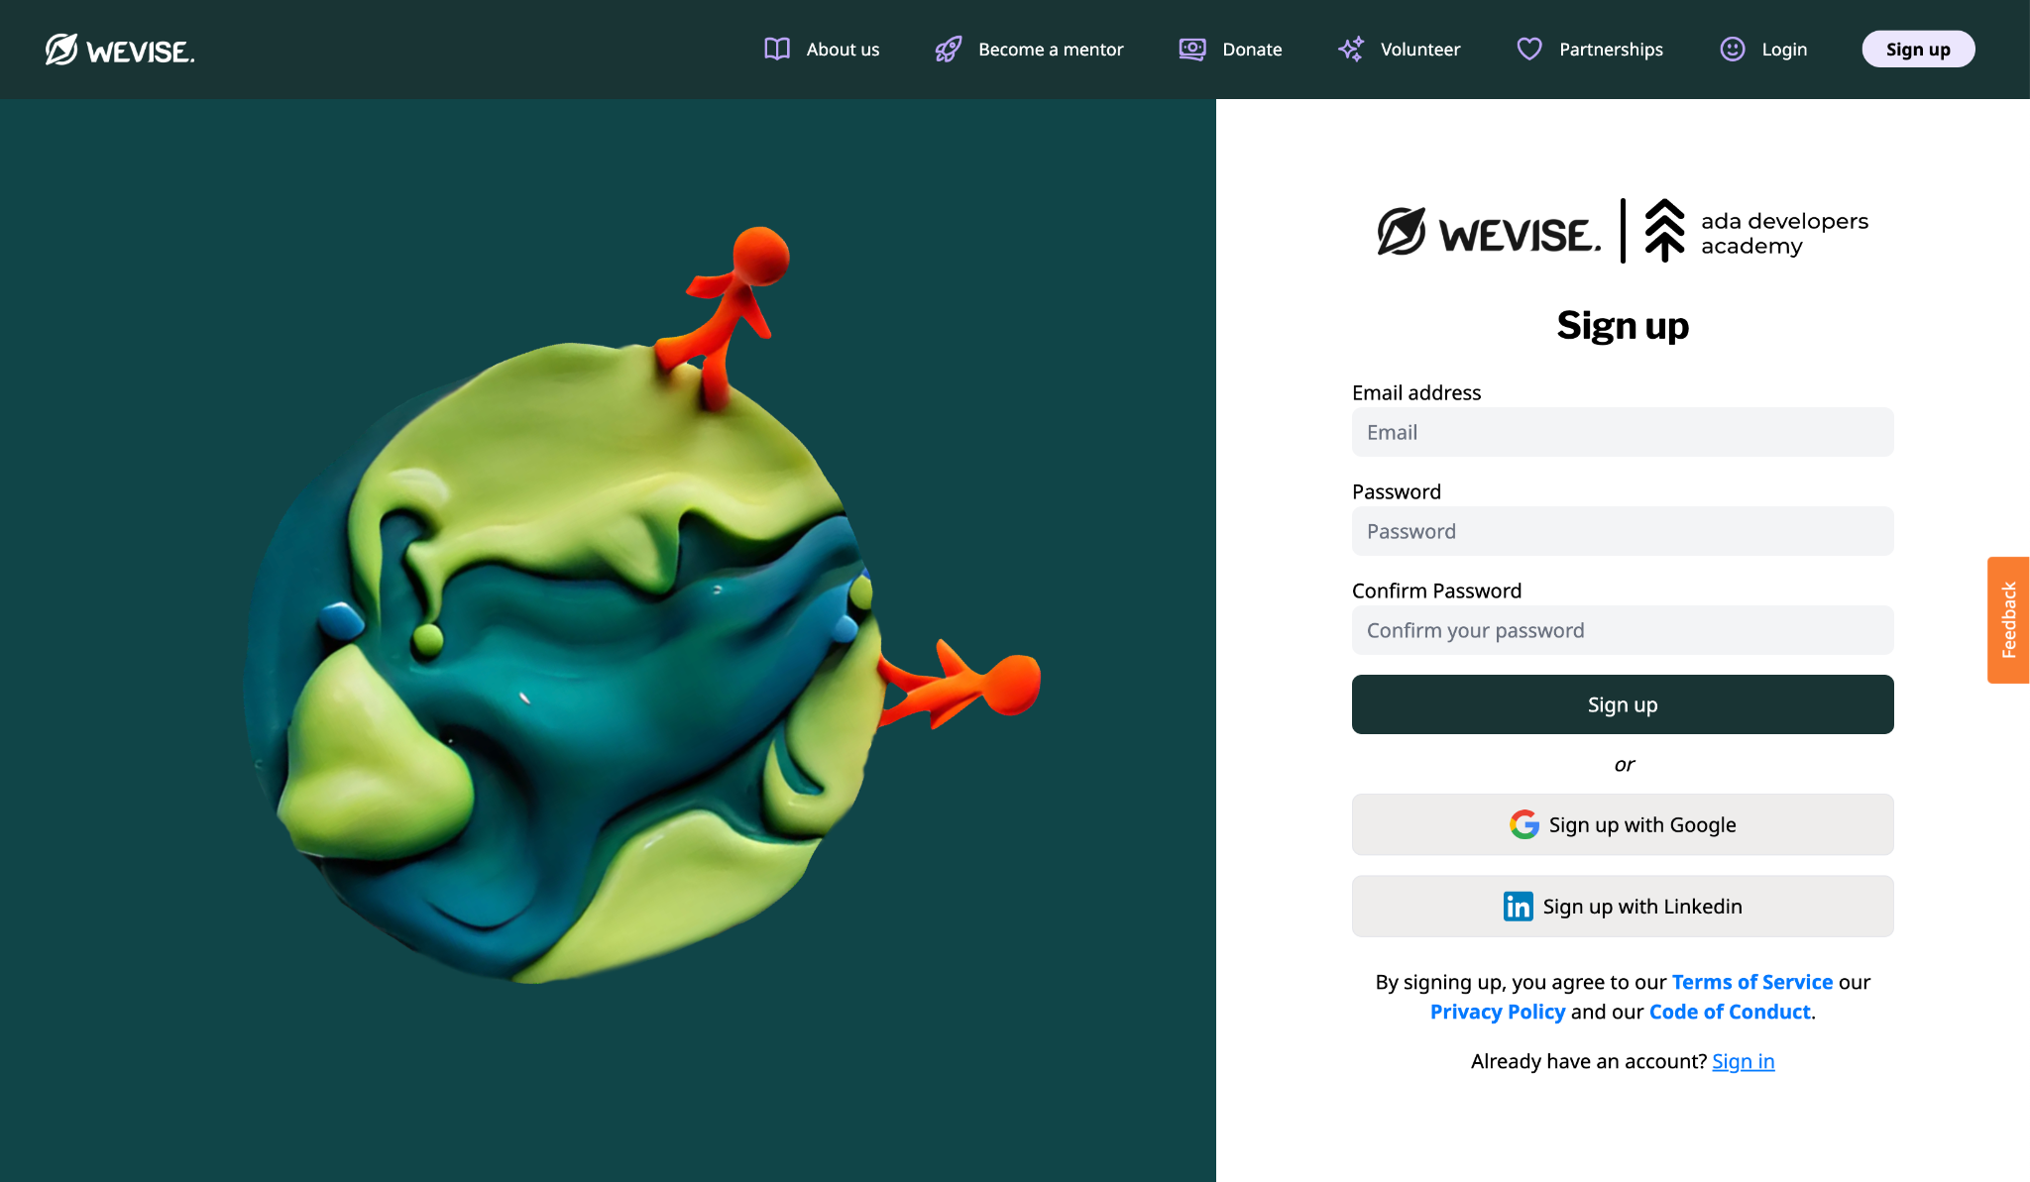
[video for mentors and mentees]
Notes:
Image links to dev site to make accounts.

Slide 14
User dashboard

Slide 15
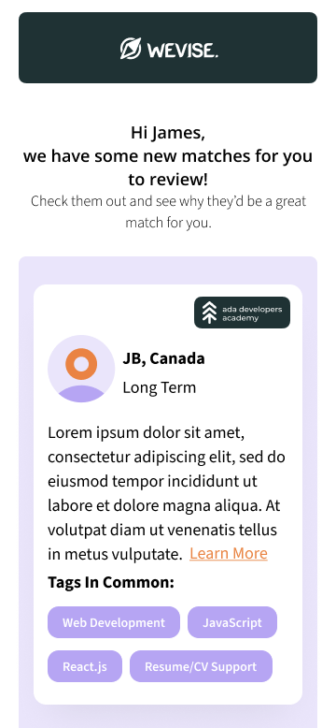
Emails received by the mentor, with organizational branding

Slide 16
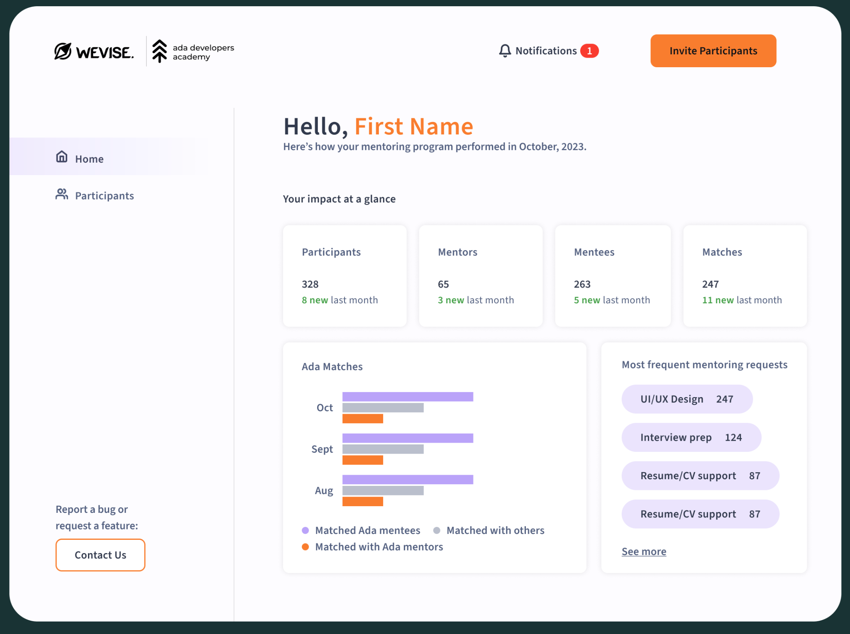
Org admin dashboard

Slide 17
Nonprofit pricing
Free for first program, beyond spreading the word and committing to bring in commensurate mentors
$10/mentee/month, plus $200 setup fee: $3,200 for 50 mentees in a six month program
$25/mentee/month, plus $200 setup fee: $7,700 for 50 mentees in a six month program (vs cost of half time person @ $33,250)
Grantwriting support, including sample language, to help cover these costs is also available.

